Slide 1
Chapter 6 Temporal Difference Learning
Intro to Reinforcement Learning
By Richard Sutton

Slide 2
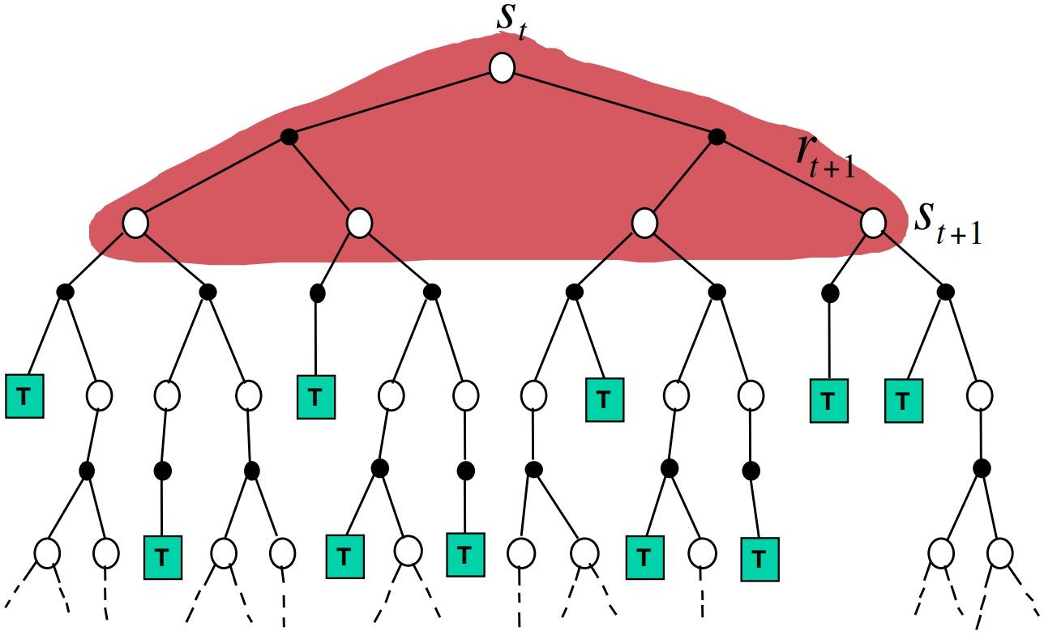
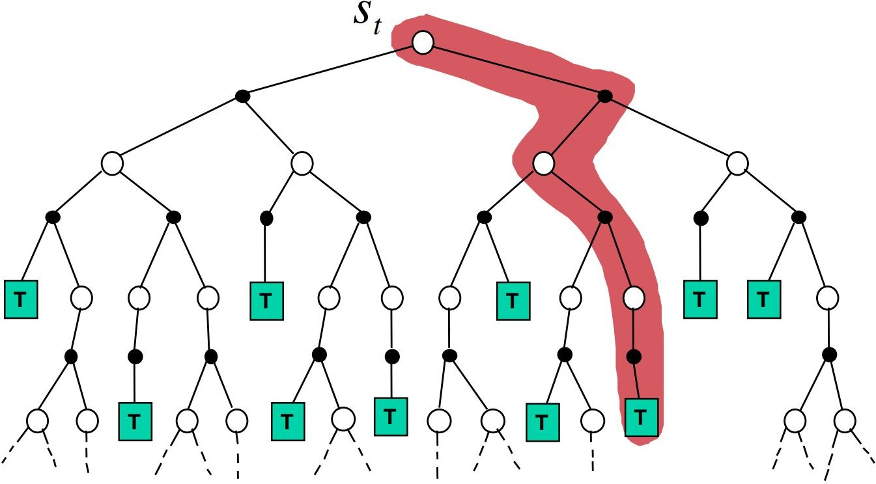
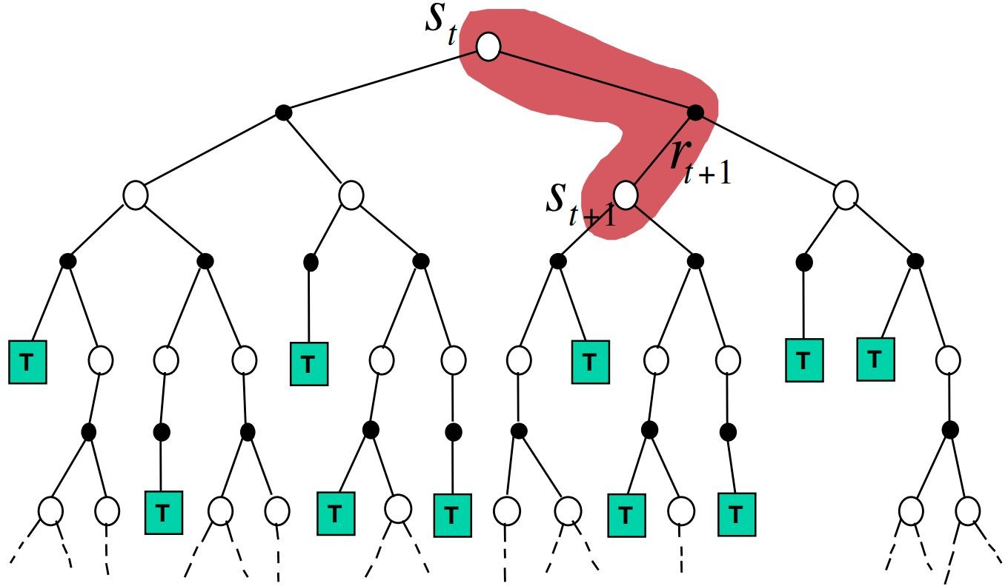
Temporal Difference (TD) Learning
Combine ideas of Dynamic Programming and Monte Carlo
Bootstrapping (DP)
Learn from experience without model (MC)
DP
MC
TD
http://www0.cs.ucl.ac.uk/staff/d.silver/web/Teaching_files/MC-TD.pdf

Slide 3
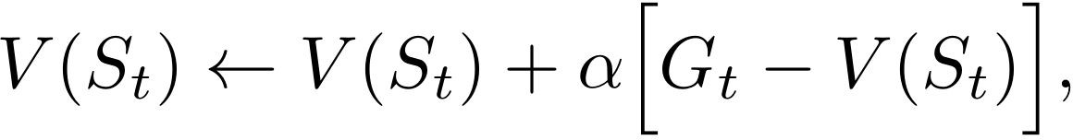
One-step TD Prediction
Monte Carlo: wait until end of episode
MC error
1-step TD / TD(0): wait until next time step
TD error
Bootstrapping target

Slide 4
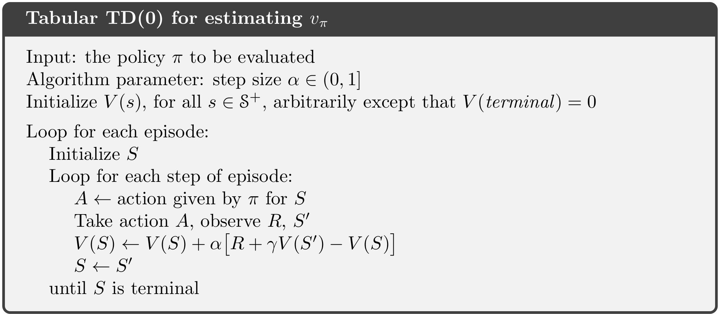
One-step TD Prediction Pseudocode

Slide 5
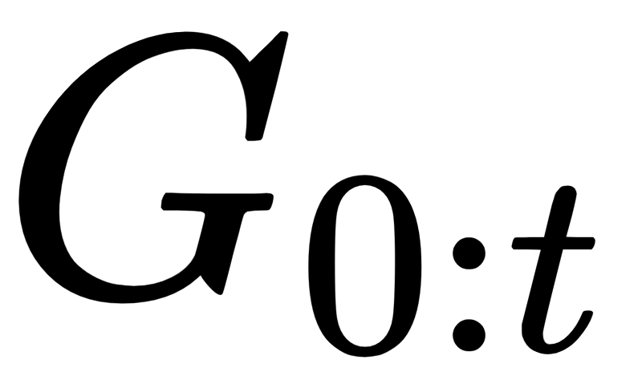
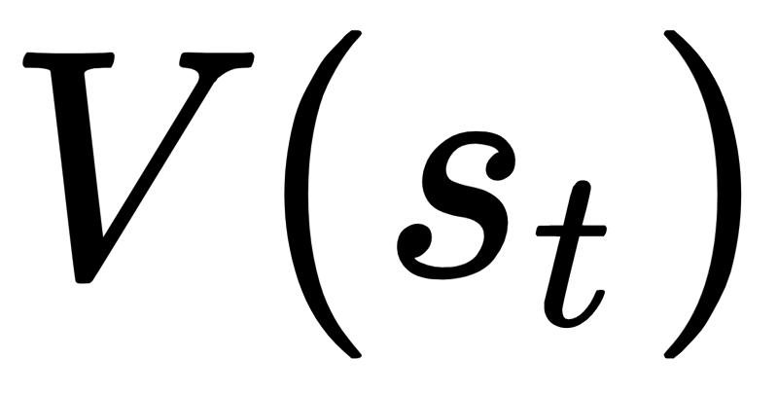
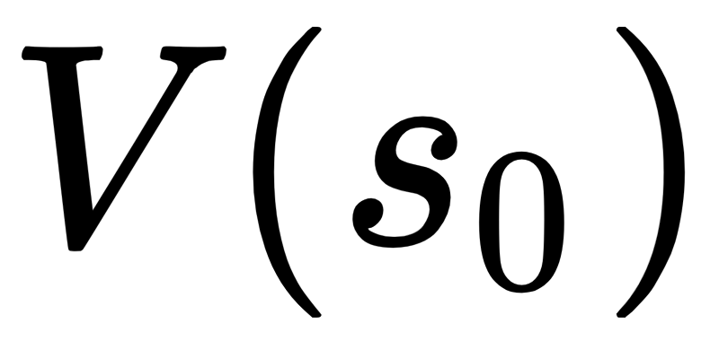
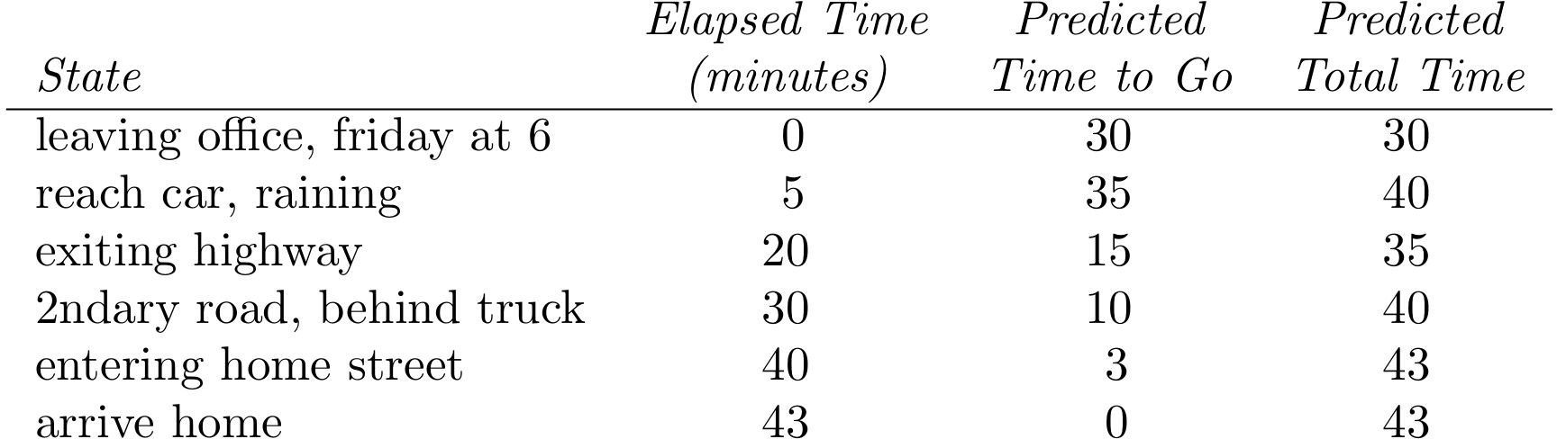
Driving Home Example
Predict how long it takes to drive home
Reward: Elapsed time for each segment
Value of state: expected time to go
Actual Remaining Time G_{t:T}
43
38
23
13
3
0

Slide 6
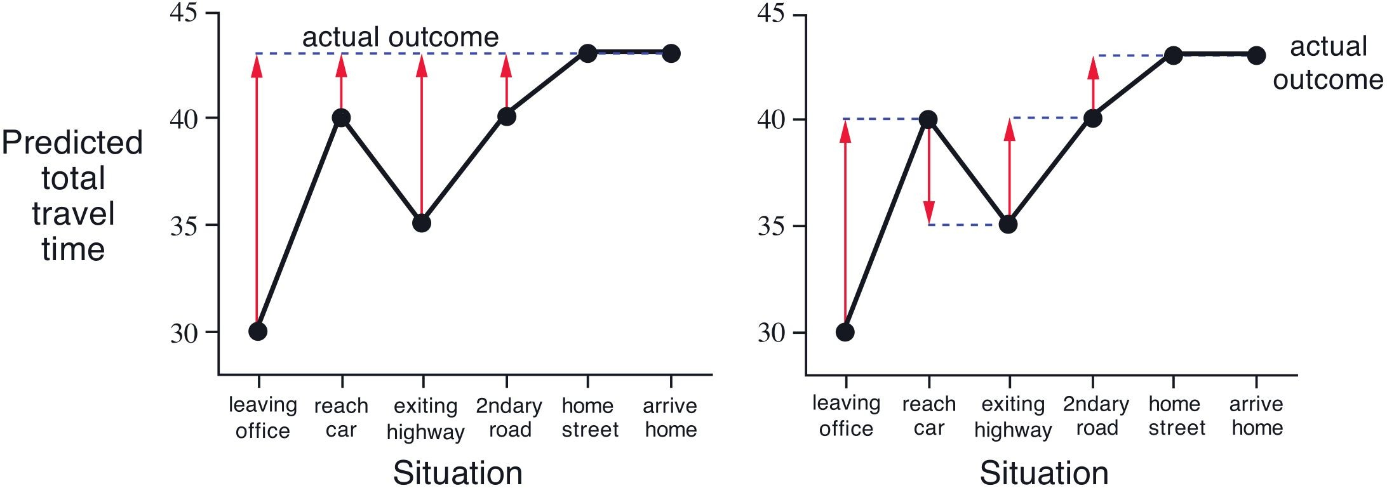
Driving Home Example: MC vs TD

Slide 7
Advantages of TD Prediction methods
vs. Dynamic Programming
No model required
vs. Monte Carlo
Allows online incremental learning
Does not need to ignore episodes with experimental actions
Still guarantees convergence
Works better for exploration
Converges faster than MC in practice
ex) Random Walk
No theoretical results yet

Slide 8
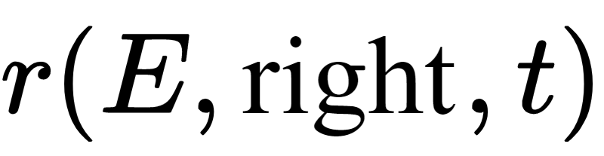
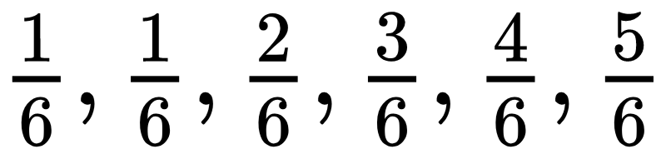
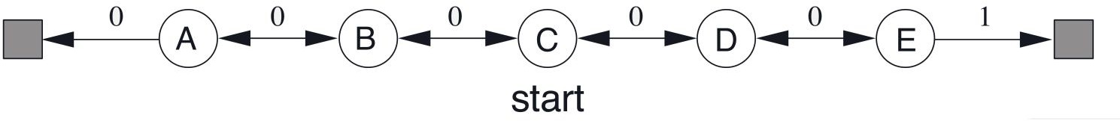
Random Walk Example
Start at C, move left/right with equal probability
Only nonzero reward is
True state values:
100 episodes for MC and TD(0)
All value estimates initialized to 0.5

Slide 9
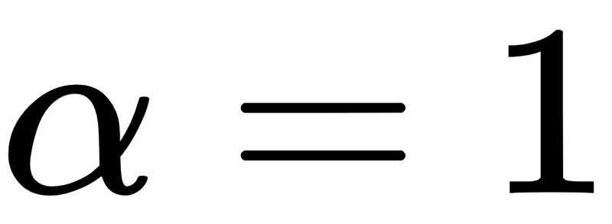
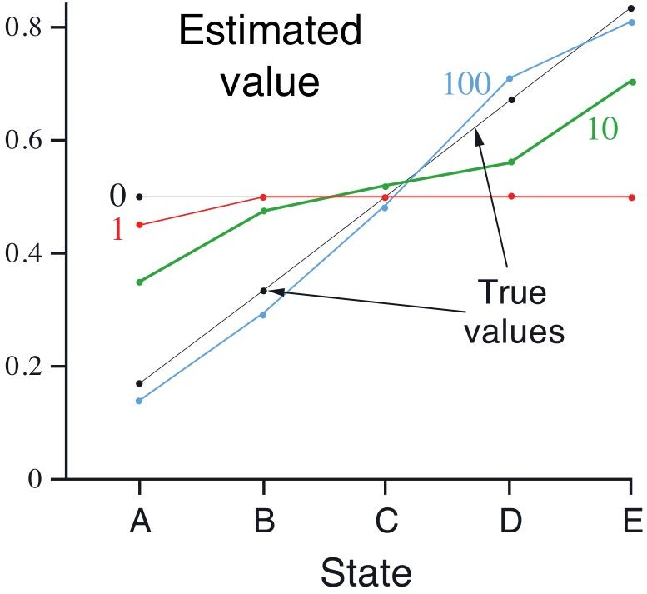
Random Walk Example: Convergence
Converges to true value
Not exactly due to step size

Slide 10
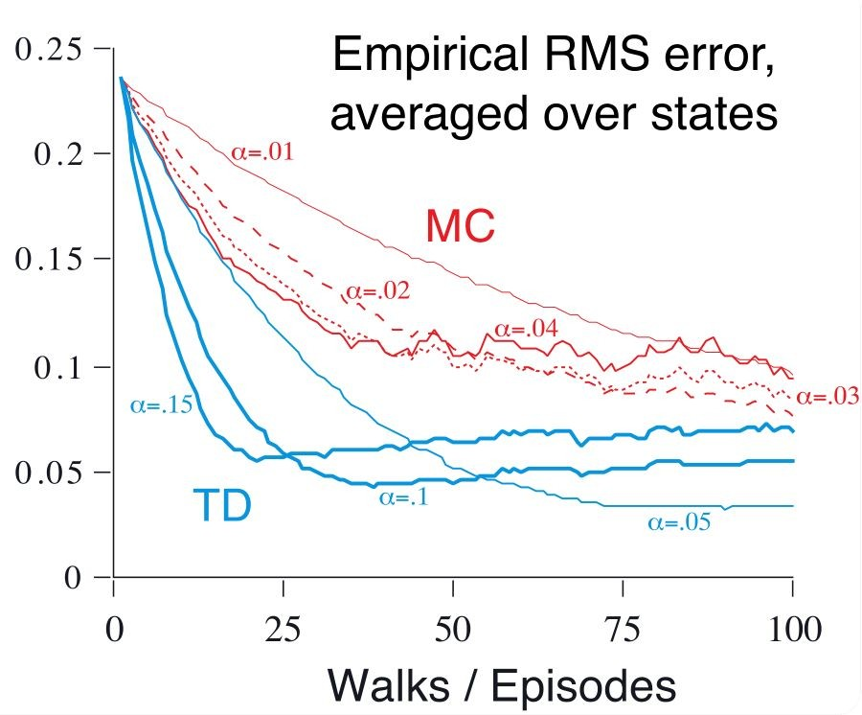
Random Walk Example: MC vs. TD(0)
RMS error decreases faster in TD(0)

Slide 11
Batch Updating
Repeat learning from same experience until convergence
Useful when finite amount of experience is available
Convergence guaranteed with small step-size parameter
MC and TD converge to different answers
ex)
Episode 1
Episode 2
Episode 3
Batch 1
Batch 2
Batch 3

Slide 12
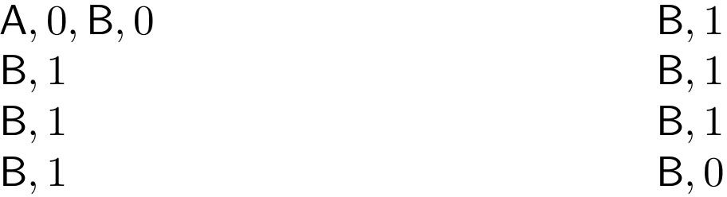
You are the Predictor Example
Suppose you observe 8 episodes:
V(B) = 6 / 8
What is V(A)?

Slide 13
You are the Predictor Example: Batch MC
State A had zero return in 1 episode → V(A) = 0
Minimize mean-squared error (MSE) on the training set
Zero error on the 8 episodes
Does not use the Markov property or sequential property within episode
A
B
0
0
1
1
1
1
1
1
0
B

Slide 14
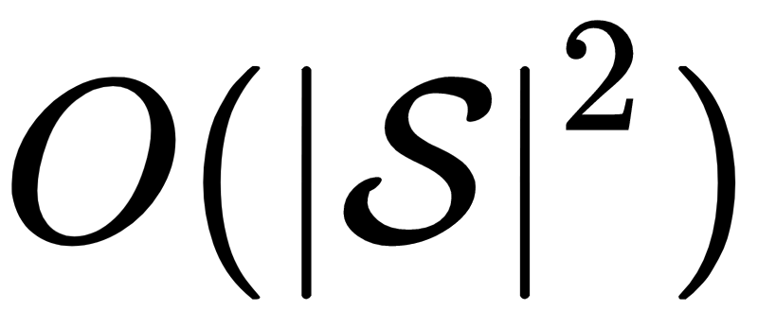
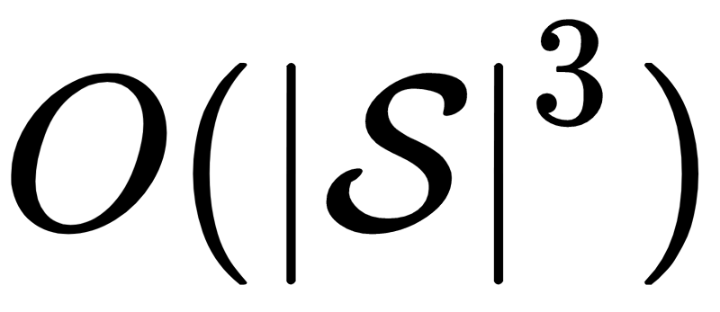
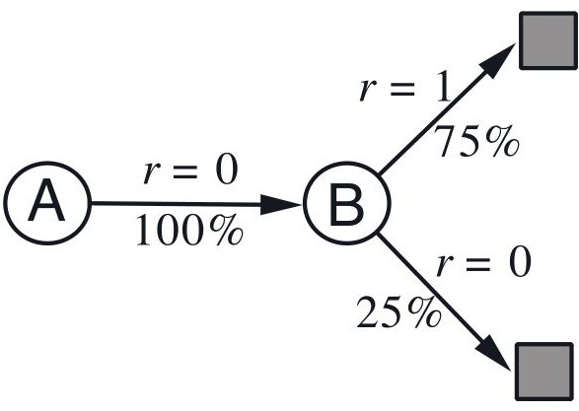
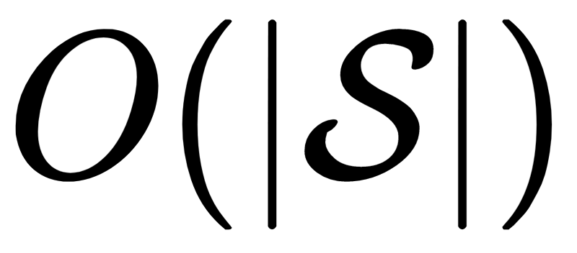
You are the Predictor Example: Batch TD(0)
A went to B 100% of the time → V(A) = V(B) = 6 / 8
Create a best-fit model of the Markov process from the training set
Model = maximum likelihood estimate (MLE)
If the model is exactly correct, we can compute the true value function
Known as the certainty-equivalence estimate
Direct computation is unfeasible ( memory, computations)
TD(0) converges to the certainty-equivalence estimate
memory needed

Slide 15
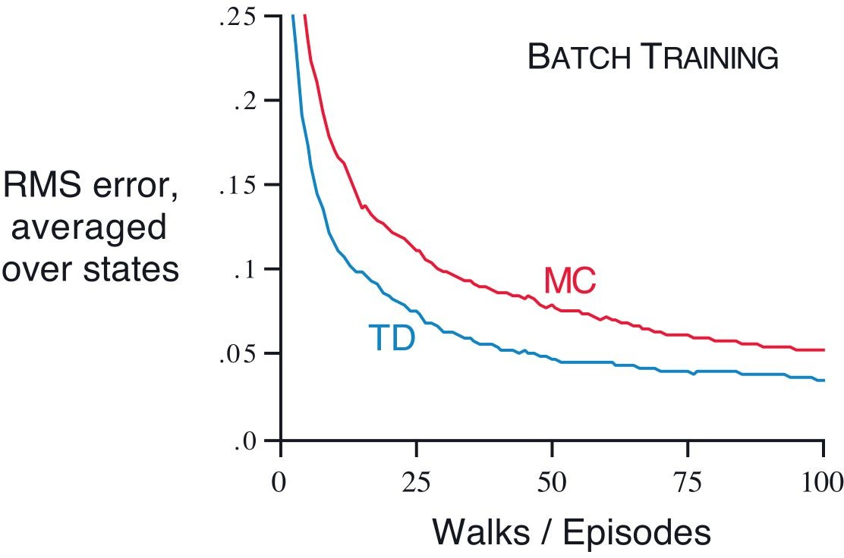
Random Walk Example: Batch Updating
Batch TD(0) has consistently lower RMS error than Batch MC

Slide 16

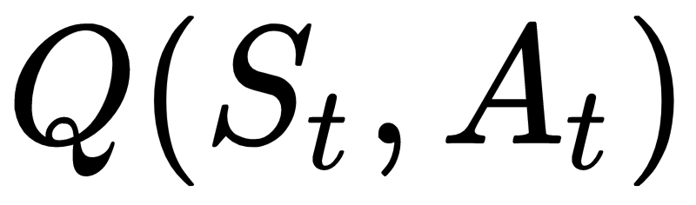

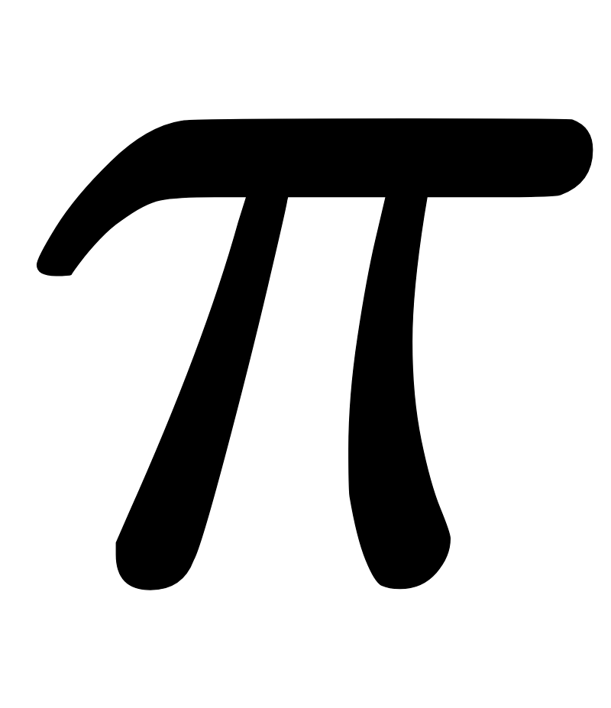
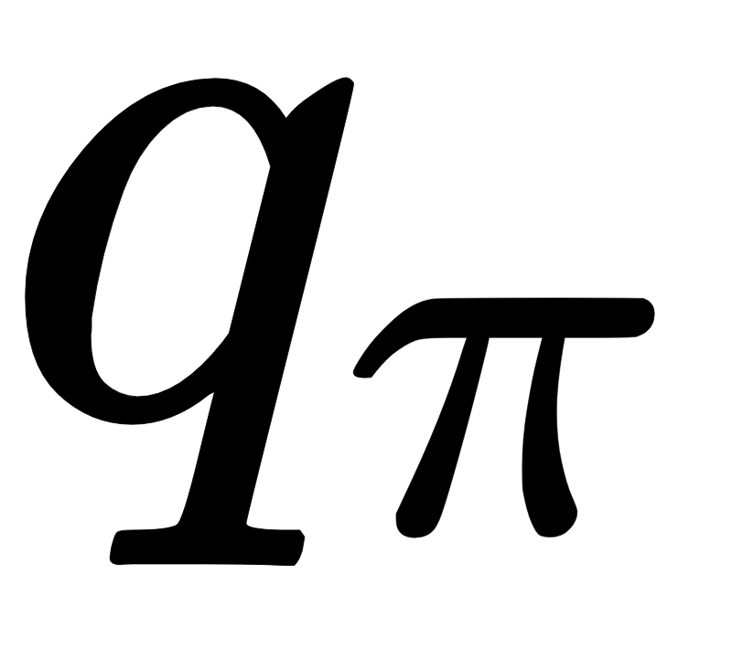
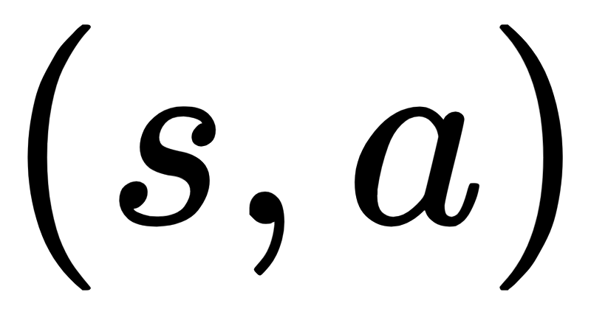
Sarsa: On-policy TD Control
Learn action-value function
Use transition
with TD(0) for updates
TD error
Change policy greedily with
Converges if:
all is visited infinitely many times
policy converges to greedy policy

Slide 17
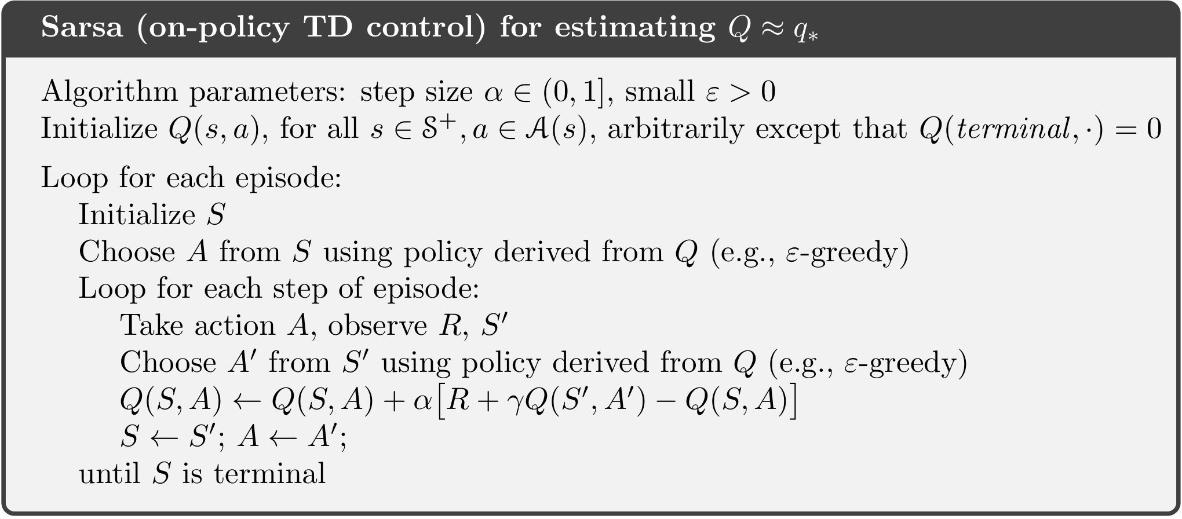
Sarsa: On-Policy TD Control Pseudocode

Slide 18
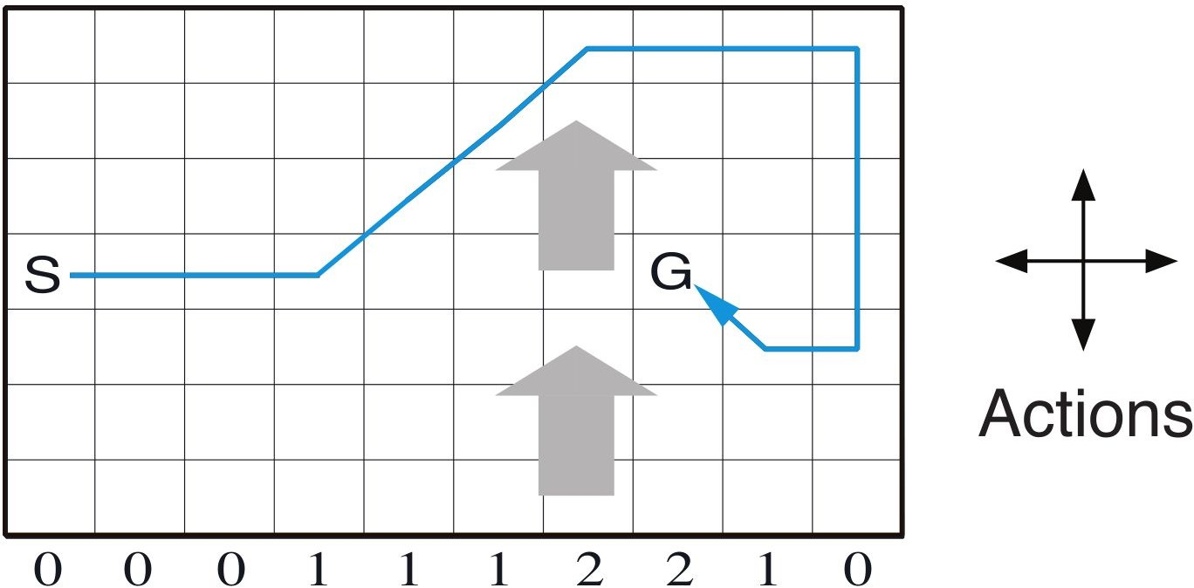
Windy Gridworld Example
Gridworld with “Wind”
Actions: 4 directions
Reward: -1 until goal
“Wind” at each column shifts agent upward
“Wind” strength varies by column
Termination not guaranteed for all policies
Monte Carlo cannot be used easily

Slide 19
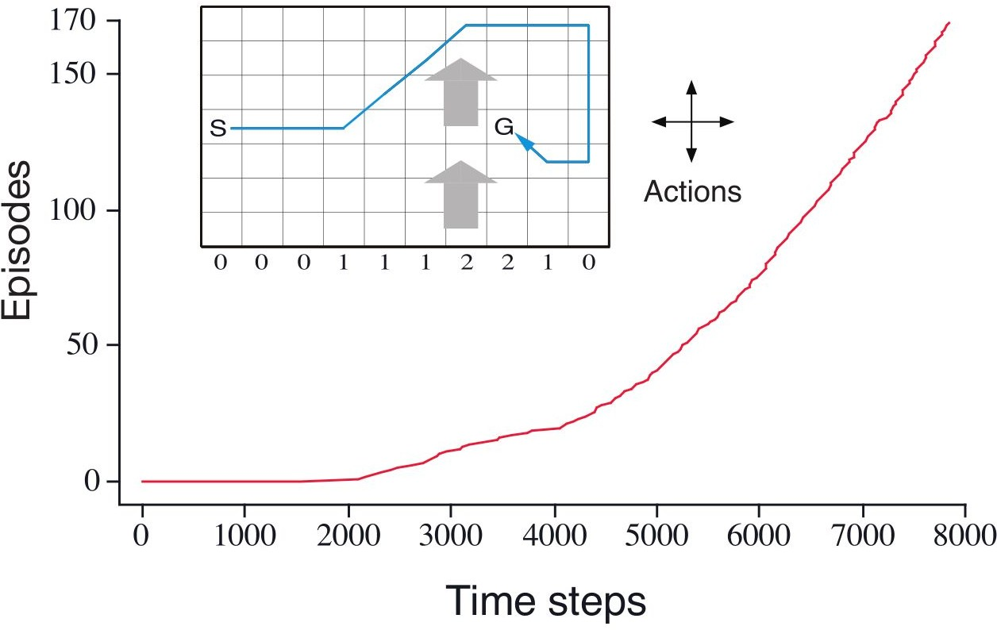
Windy Gridworld Example
Converges at 17 steps (instead of optimal 15) due to exploring policy

Slide 20
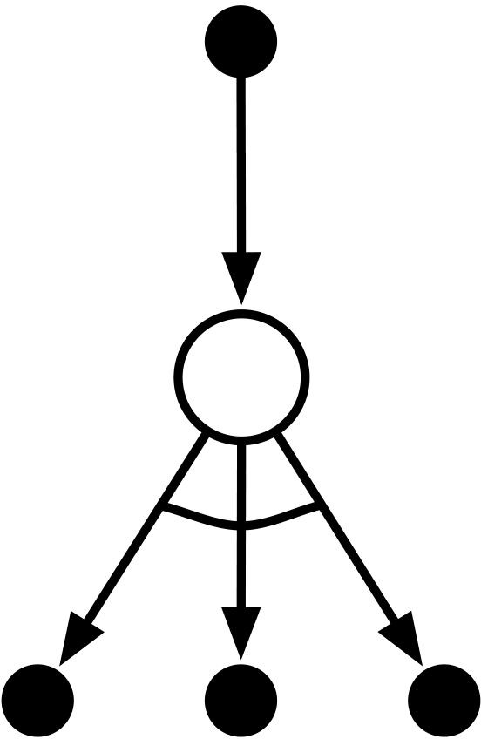

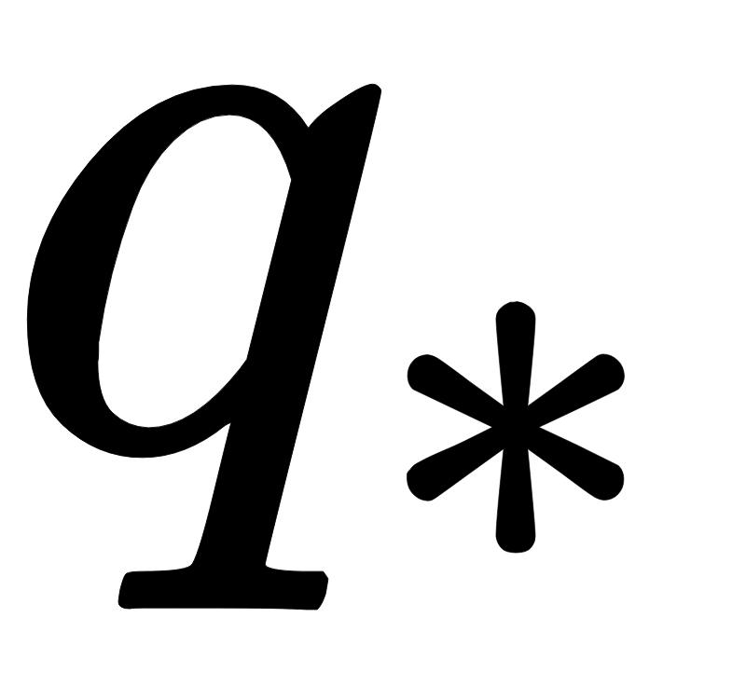
Q-learning: Off-policy TD Control
directly approximates independent of behavior policy
Converges if all
is visited infinitely many times

Slide 21
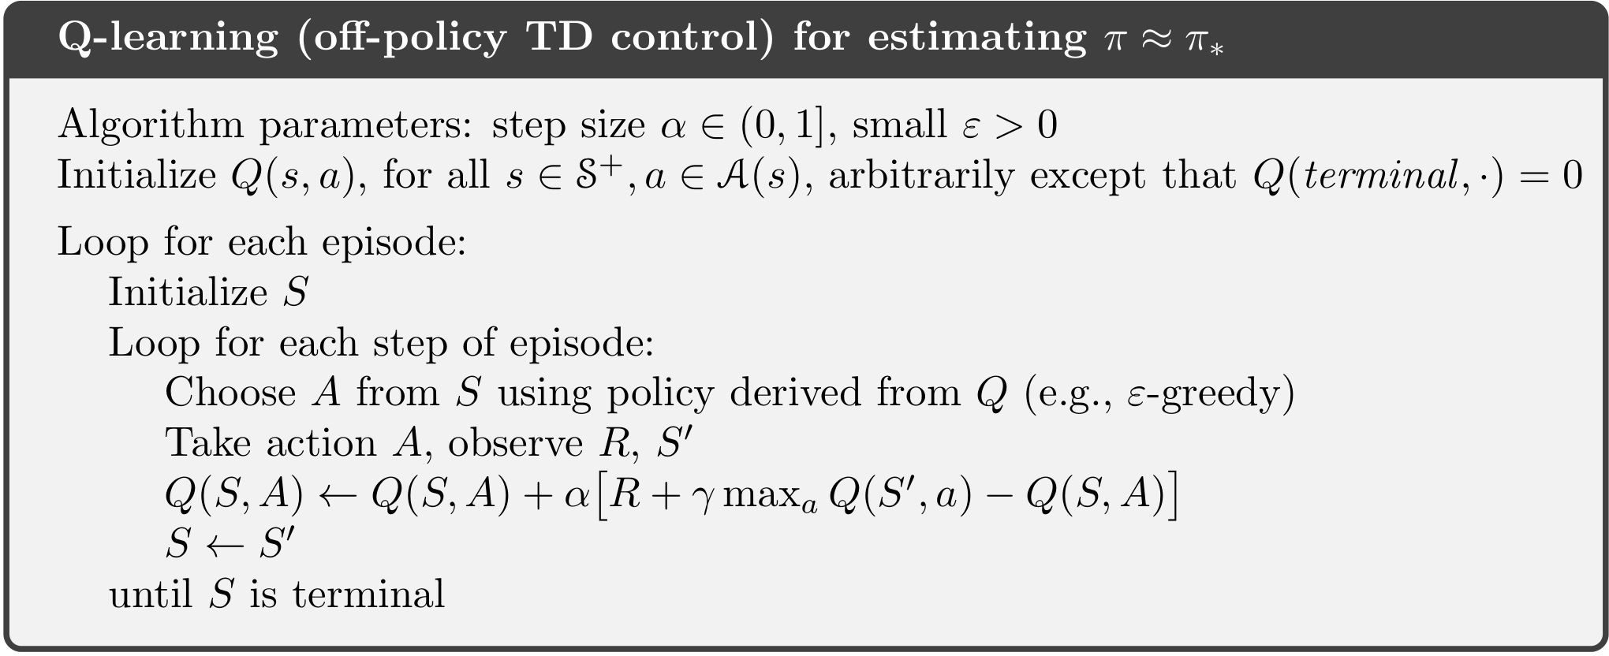
Q-learning: Off-policy TD Control: Pseudocode

Slide 22
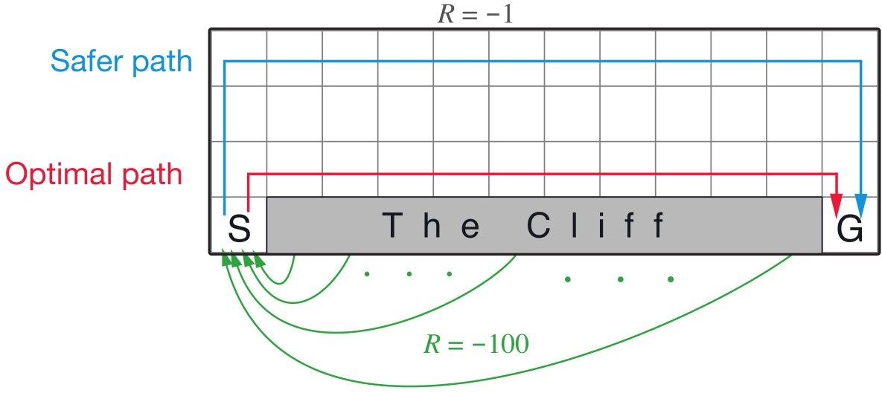
Cliff Walking Example
Gridworld with “cliff” with high negative reward
ε-greedy (behavior) policy for both Sarsa and Q-learning (ε = 0.1)

Slide 23
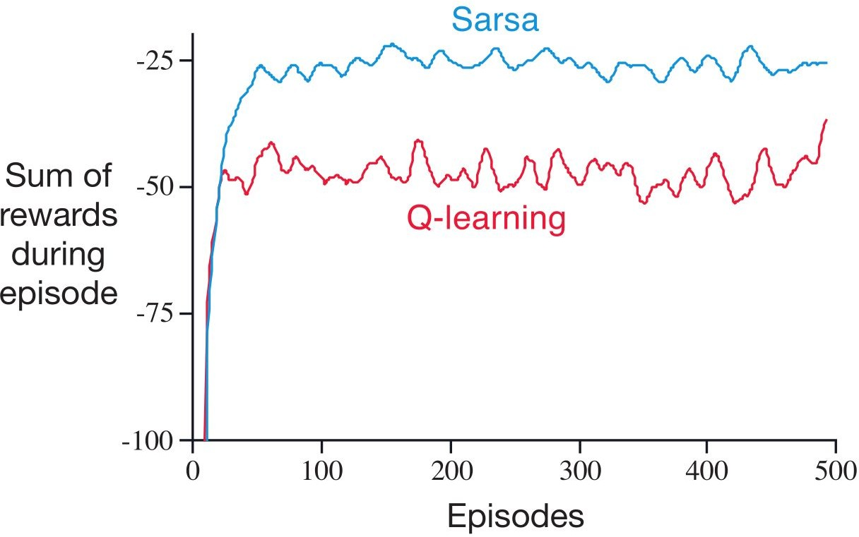
Cliff Walking Example: Sarsa vs. Q-learning
Q-learning learns optimal policy
Sarsa learns safe policy
Q-learning has worse online performance
Both reach optimal policy with ε-decay

Slide 24
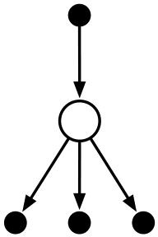
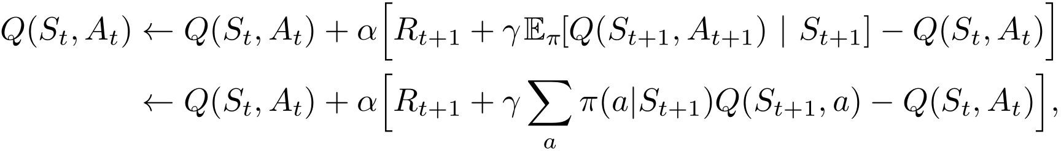
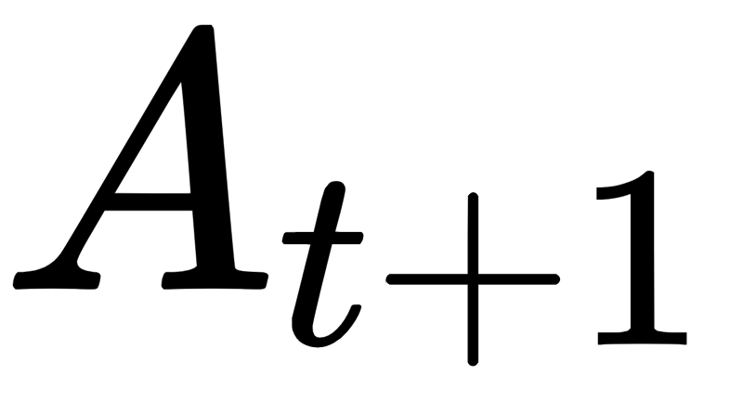
Expected Sarsa
Instead of maximum (Q-learning), use expected value of Q
Eliminates Sarsa’s variance from random selection of in ε-soft
“May dominate Sarsa and Q-learning except for small computational cost”

Slide 25
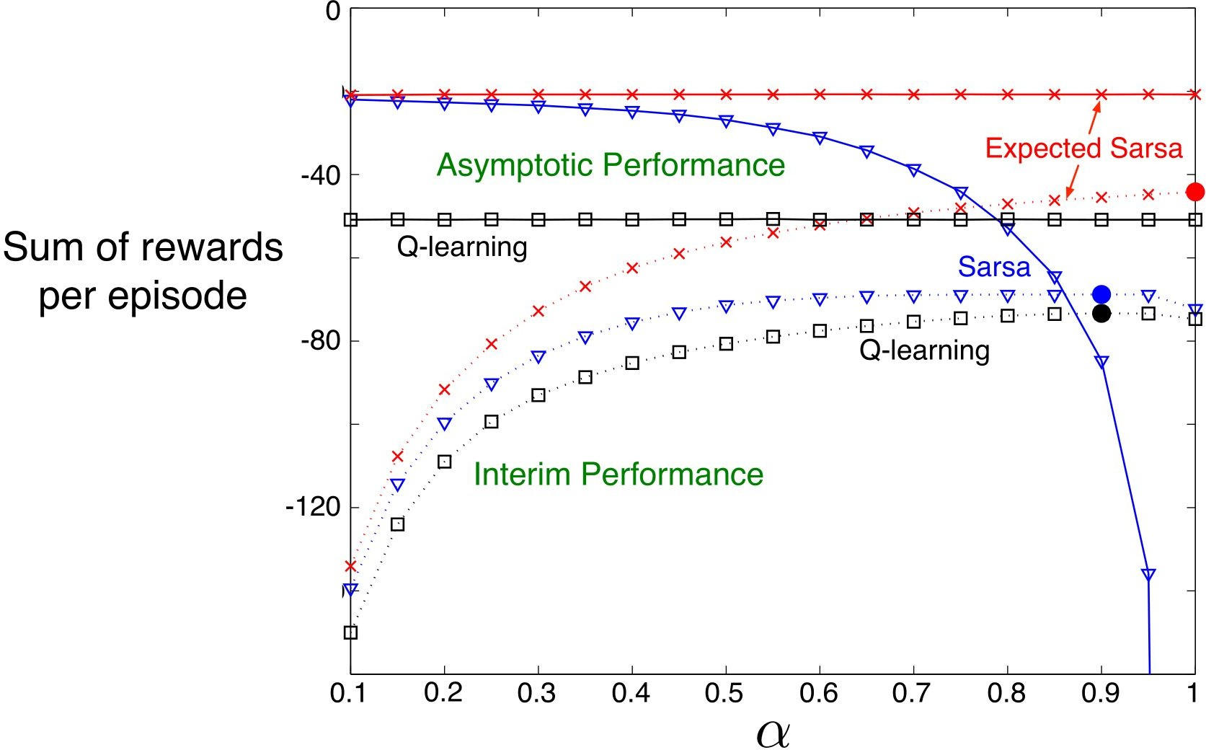
Cliff Walking Example: Parameter Study

Slide 26
Maximization Bias
All shown control algorithms involve maximization
Sarsa: ε-greedy policy
Q-learning: greedy target policy
Can introduce significant positive bias that hinders learning

Slide 27
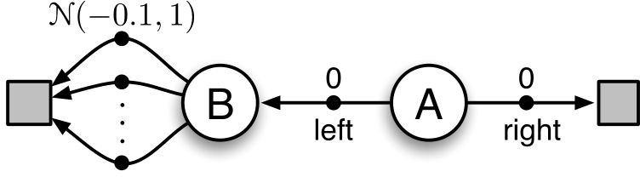
Maximization Bias Example
Actions and Reward
left / right in A, reward 0
10 actions in B, each gives reward from N(-0.1, 1)
Best policy is to always choose right in A

Slide 28
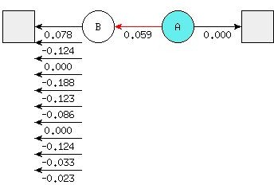
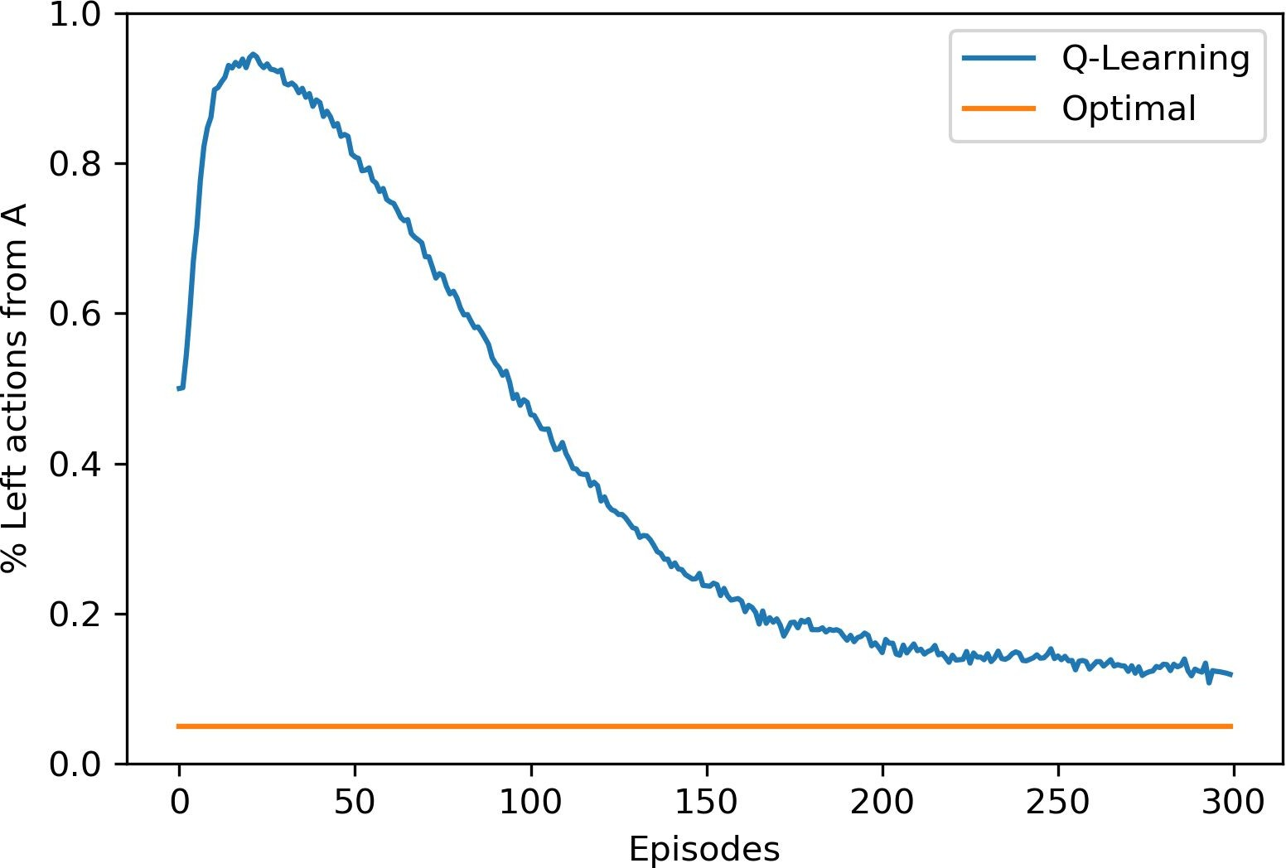
Maximization Bias Example
One positive action value causes maximization bias
https://www.endtoend.ai/sutton-barto-notebooks

Slide 29
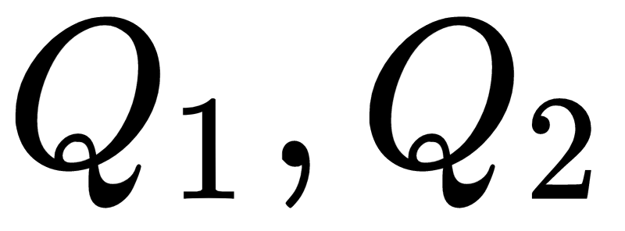
Double Q-Learning
Maximization bias stems from using the same sample in two ways:
Determining the maximizing action
Estimating action value
Use two action-values estimates
Update one with equal probability:
Can use average or sum of both
for ε-greedy behavior policy

Slide 30
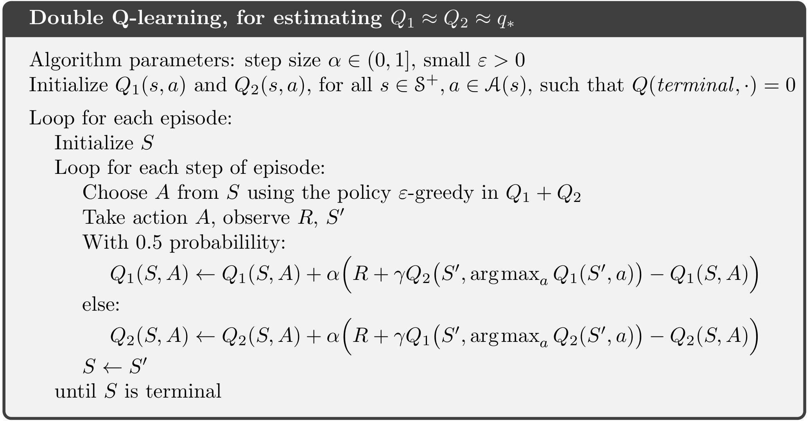
Double Q-Learning Pseudocode

Slide 31
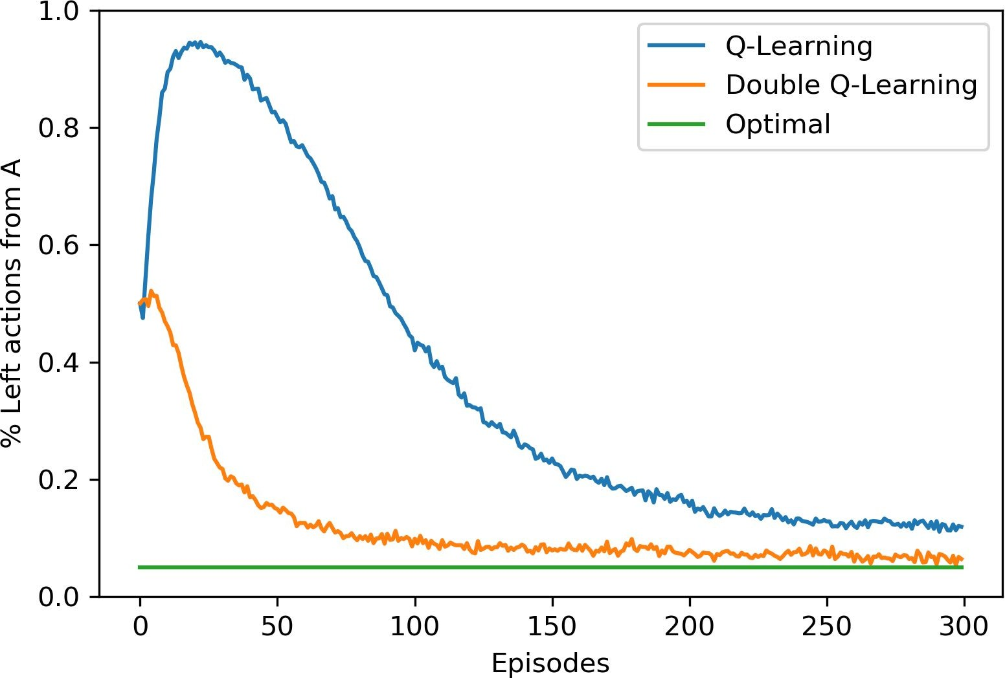
Double Q-Learning Result

Slide 32
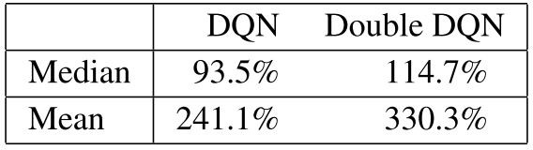
Double Q-Learning in Practice: Double DQN
Singificantly improves to Deep Q-Network (DQN)
Q-Learning with Q estimated with artificial neural networks
Implemented in almost all DQN papers afterwards
Results on Atari 2600 games
https://arxiv.org/abs/1509.06461

Slide 33
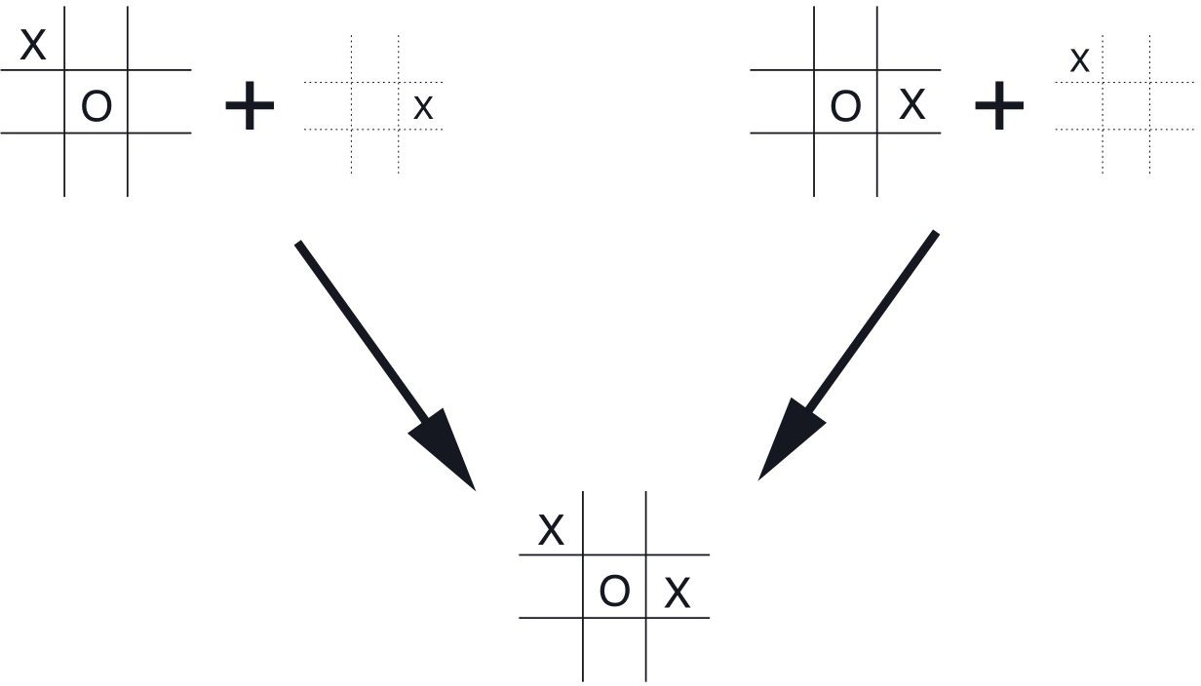
Afterstate Value Functions
Evaluate the state after the action (afterstate)
Useful when:
the immediate effect of action is known
multiple can lead to same afterstate

Slide 34
Summary
Can be applied on-line with minimal amount of computation
Uses experience generated from interaction
Expressed simply by single equations
→ Used most widely in Reinforcement Learning
This was one-step, tabular, model-free TD methods
Can be extended in all three ways to be more powerful

Slide 35
References
Reinforcement Learning: An Introduction by Sutton and Barto
Reinforcement-learning-an-introduction-chapter-6

